Slide 1
Anomaly Detection in Network Security
Mirukula Pravalika
Bhavishya Karakala
Dharani Nomula

Slide 2
Introduction
Our project focuses on making sure computer systems and networks are safe from bad actors who might try to break in and cause harm.
Objective: Detect unusual network activities for security threat identification using machine learning with PySpark.
Project Goals:: Develop a robust anomaly detection system and compare machine learning performance with and without PySpark for scalability.

Slide 3
Dataset and Approach Overview
Approach:
Utilize machine learning algorithm
Integrate big data analytics tools.
Dataset:
UNSW-NB16 dataset over 2.5 million records distributed across four CSV files (UNSW_NB15_1.csv, UNSW_NB15_2.csv, UNSW_NB15_3.csv, UNSW_NB15_4.csv).
Tools:
machine learning algorithms in google Colab.(RandomForestClassifier)
Big data analytics tools-Apache Spark(Google Colab- Pyspark

Slide 4
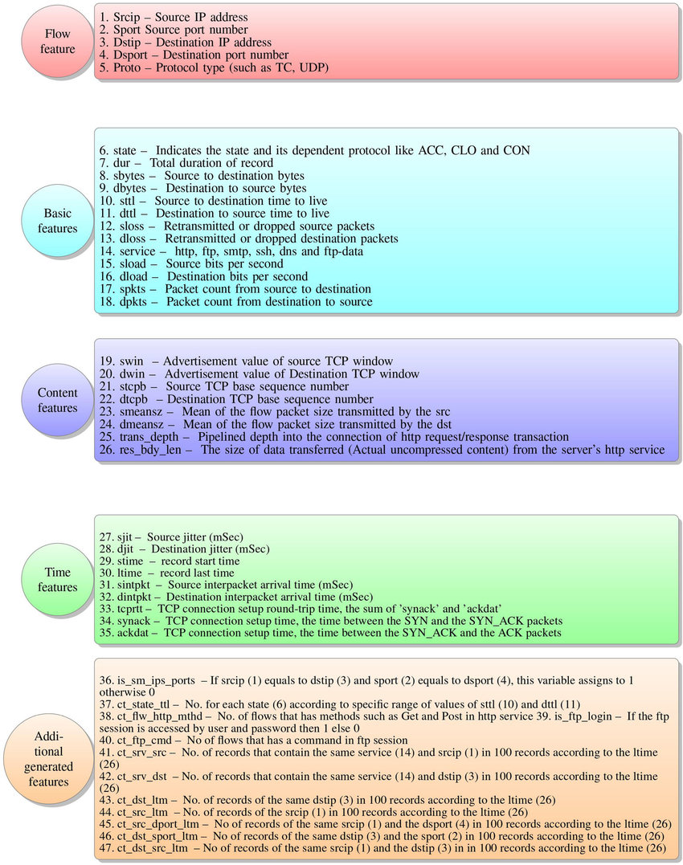
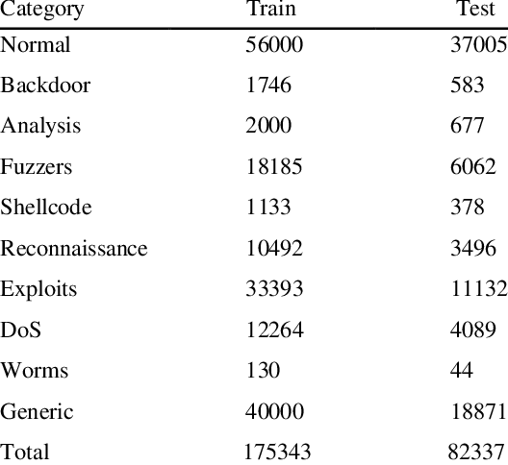
Source:
https://www.google.com/url?sa=i&url=https%3A%2F%2Fwww.researchgate.net%2Ffigure%2FFeatures-description-of-UNSW-NB15-dataset-96_fig1_354134598&psig=AOvVaw1JqyAx27SRYcalB8jWoShs&ust=1712767587782000&source=images&cd=vfe&opi=89978449&ved=0CBIQjRxqFwoTCICtkc_KtYUDFQAAAAAdAAAAABAE
https://www.google.com/url?sa=i&url=https%3A%2F%2Fwww.researchgate.net%2Ffigure%2FFeatures-description-of-UNSW-NB15-dataset-96_fig1_354134598&psig=AOvVaw1JqyAx27SRYcalB8jWoShs&ust=1712767587782000&source=images&cd=vfe&opi=89978449&ved=0CBIQjRxqFwoTCICtkc_KtYUDFQAAAAAdAAAAABAE

Slide 5
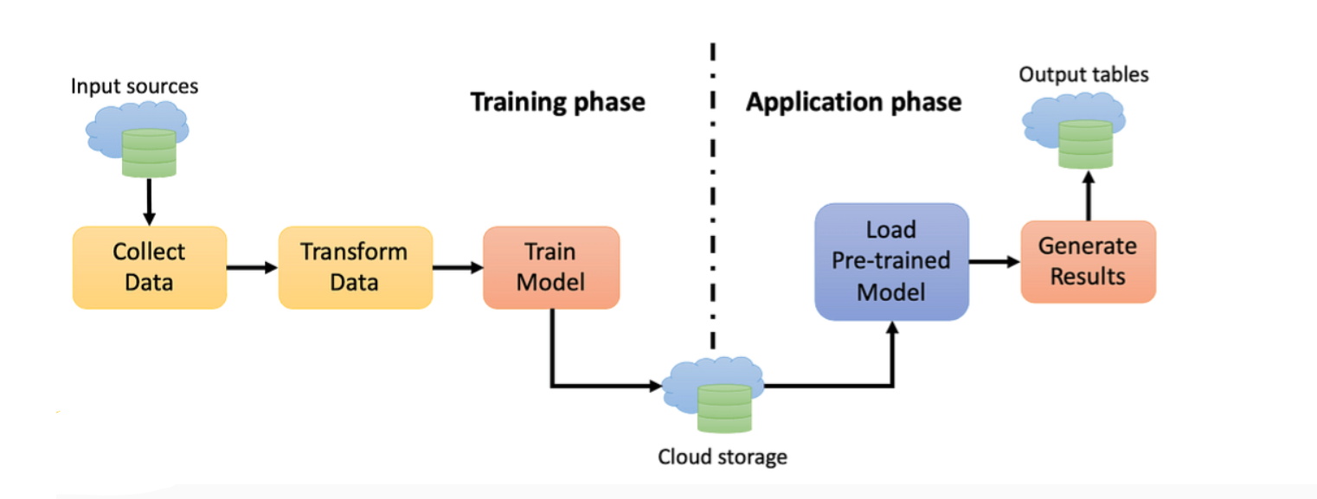
Source: https://statusneo.com/building-a-machine-learning-ml-model-with-pyspark/

Slide 6
PySpark
Efficient and distributed computing engine that enables processing of massive datasets across clusters.
Scalability
Ease of Use
Machine Learning with MLlib
DataFrame API

Slide 7
PySpark for Scalable Anomaly Detection
A powerful open-source framework for large-scale data processing and machine learning, built on top of Apache Spark.
Set up PySpark Environment
Load Data into Spark DataFrame
Data Preprocessing and Feature Engineering
Train Machine Learning Model with PySpark Mllib
Model Evaluation and Prediction

Slide 8
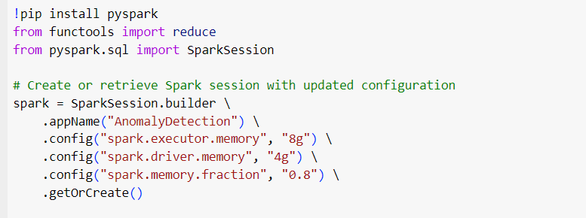
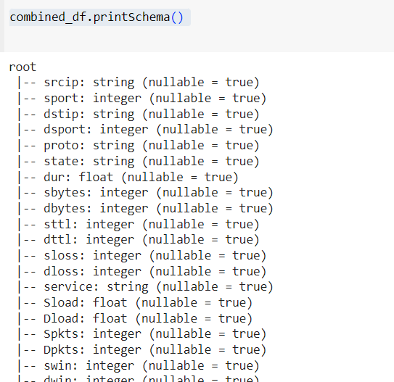
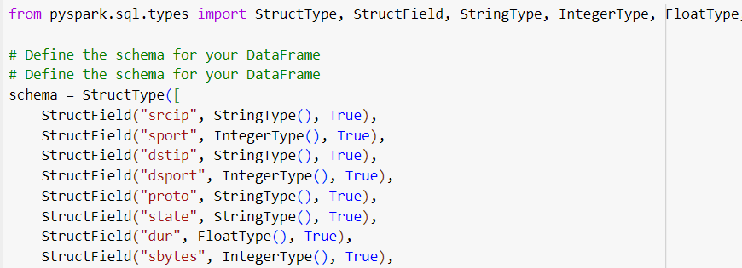

Slide 9
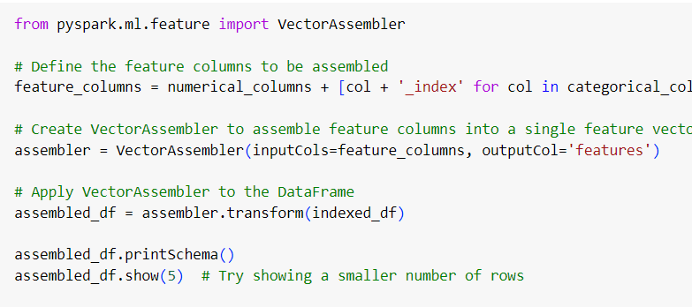
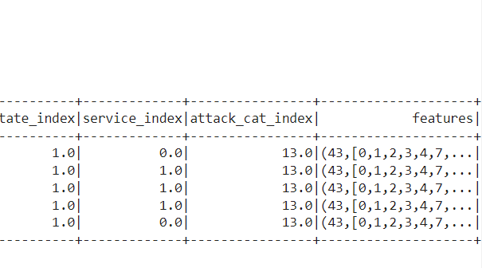
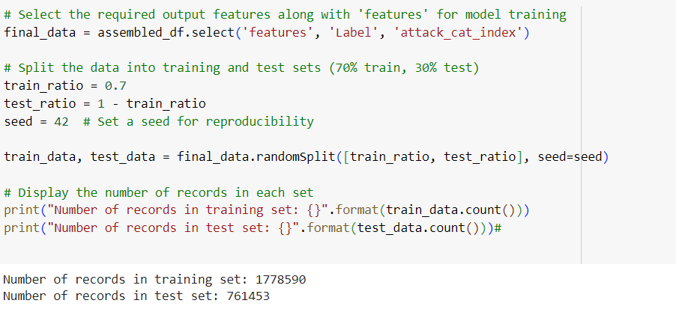

Slide 10
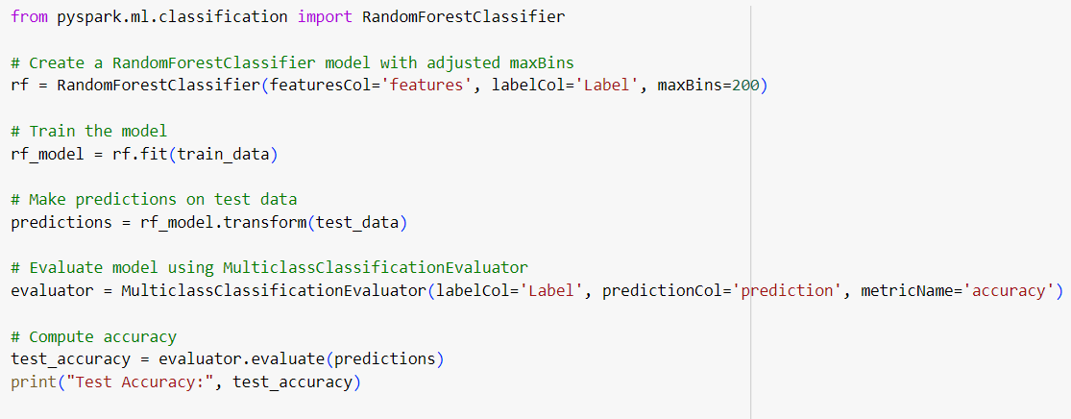
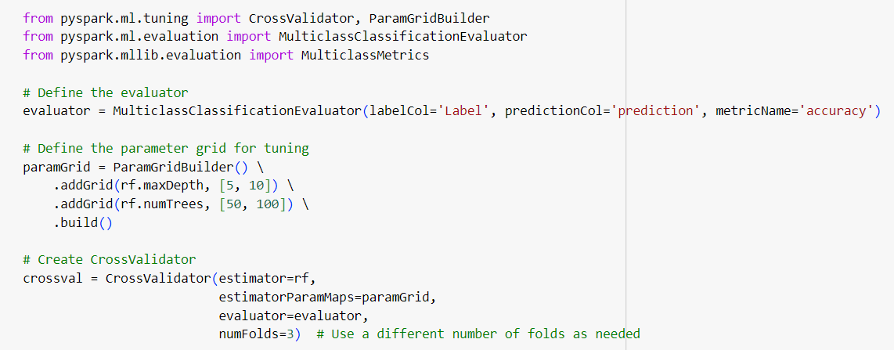

Slide 11
Results
Leveraging PySpark can lead to improved accuracy, precision, and recall in identifying and mitigating cybersecurity threats.
 | Precision Score | Recall Score | Accuracy Score
with Pyspark | 0.9952 | 0.977 | 0.98685
Without Pyspark | 0.9785 | 0.9912 | 0.9697

Slide 12
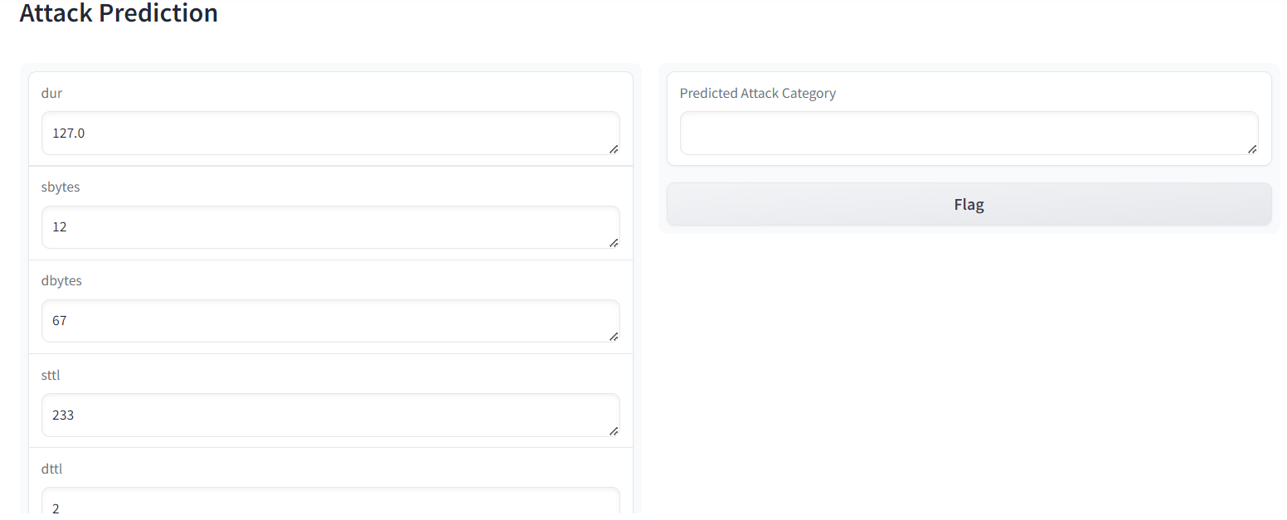
Gradio Application implementation:

Slide 13
Challenges
Handling Large-Scale Data
Data Volume and Processing Speed

Slide 14
References:
https://www.kaggle.com/datasets/mrwellsdavid/unsw-nb15/data?select=UNSW-NB15_1.csv
https://statusneo.com/building-a-machine-learning-ml-model-with-pyspark/
https://www.projectpro.io/hadoop-tutorial/pyspark-machine-learning-tutorial

Slide 15
Thank you

